Slide 1
Graphical Models

Slide 2
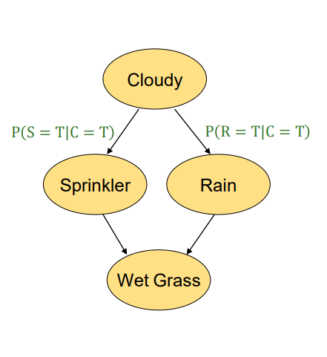
Graphical models
Mr. Holmes leaves his house
The grass is wet in front of his house.
Two reasons are possible: either it rained or the sprinkler of Holmes has been on during the night.
Then, Mr. Holmes looks at the sky and finds it is cloudy
Since when it is cloudy, usually the sprinkler is off and it is more possible it rained.
He concludes it is more likely that rain causes grass wet.
What causes grass wet?

Slide 3
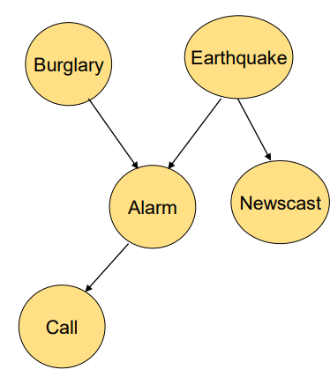
Graphical models
Mr. Holmes is in his office
He receives a call from his neighbor that the alarm of his house went off.
He thinks that somebody broke into his house.
Afterwards he hears an announcement from radio that a small earthquake just happened
Since the alarm has been going off during an earthquake.
He concludes it is more likely that earthquake causes the alarm.

Slide 4
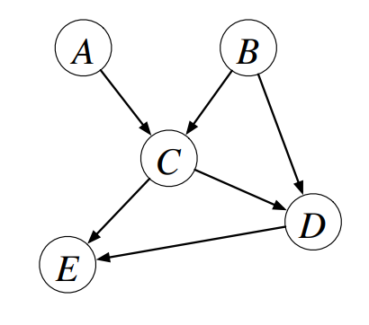
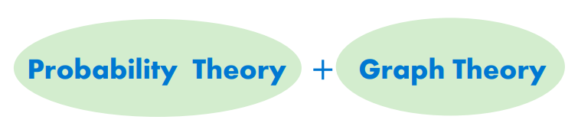
Graphical Models
A graphical model is a way of representing probabilistic relationships between random variables
Probability theory: ensures consistency, provides interface models to data.
Graph theory: intuitively appealing interface for humans. “The graphical language allows us to encode in practice: the property that variables tend to interact directly only with very few others”.
Modularity: a complex system is built by combining simpler parts.

Slide 5
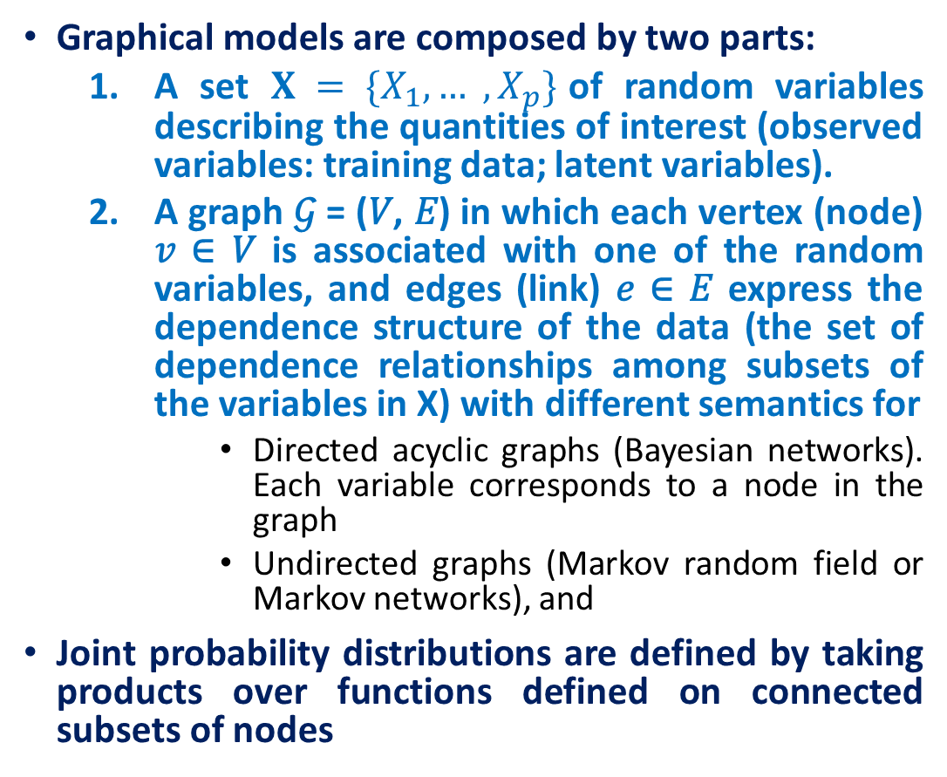
Graphical models

Slide 6
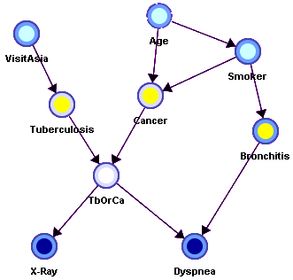
Directed Graphical Models
A probabilistic model for which a graph denotes the conditional independence structure between random variables.
Bayesian network (directed acyclic graph)

Slide 7
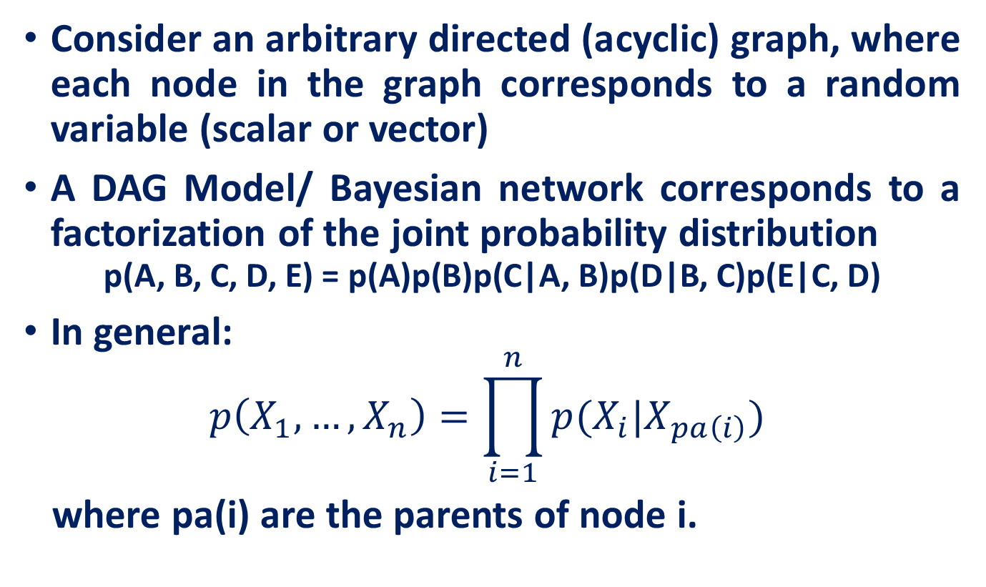
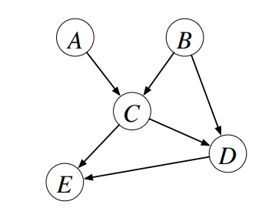
Directed Graphical Models

Slide 8
Bayesian Learning
Bayes Theorem
Bayes optimal classifier
Naive Bayes learner
Bayesian belief networks

Slide 9
Bayesian Learning-Advantages
Bayesian reasoning provides a probabilistic approach to inference.
It is based on the assumption that the quantities of interest are governed by probability distributions and that optimal decisions can be made by reasoning about these probabilities together with observed data.
it provides a quantitative approach to weighing the evidence supporting alternative hypotheses.
Bayesian reasoning provides the basis for learning algorithms that directly manipulate probabilities, as well as a framework for analyzing the operation of other algorithms that do not explicitly manipulate probabilities.

Slide 10
Bayesian Learning -Relevance
Bayesian learning algorithms that calculate explicit probabilities for hypotheses, such as the naive Bayes classifier, are among the most practical approaches to certain types of learning problems.
They provide a useful perspective for understanding many learning algorithms that do not explicitly manipulate probabilities.

Slide 11
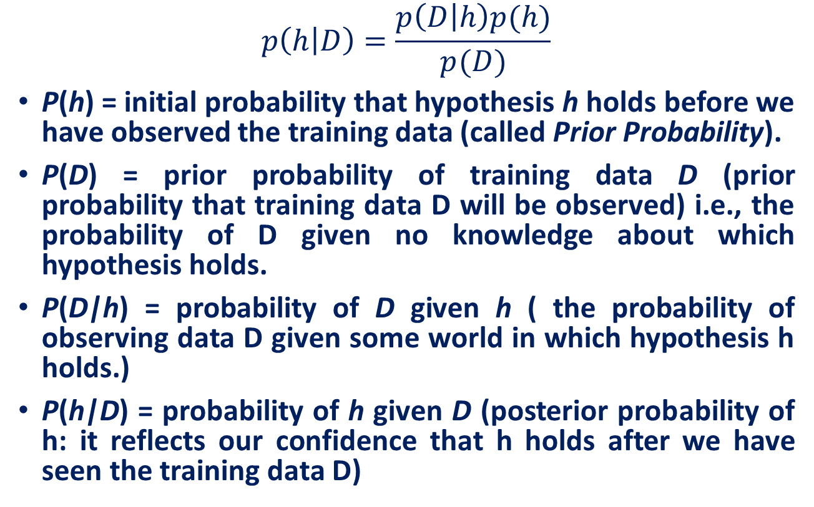
Bayes Theorem

Slide 12
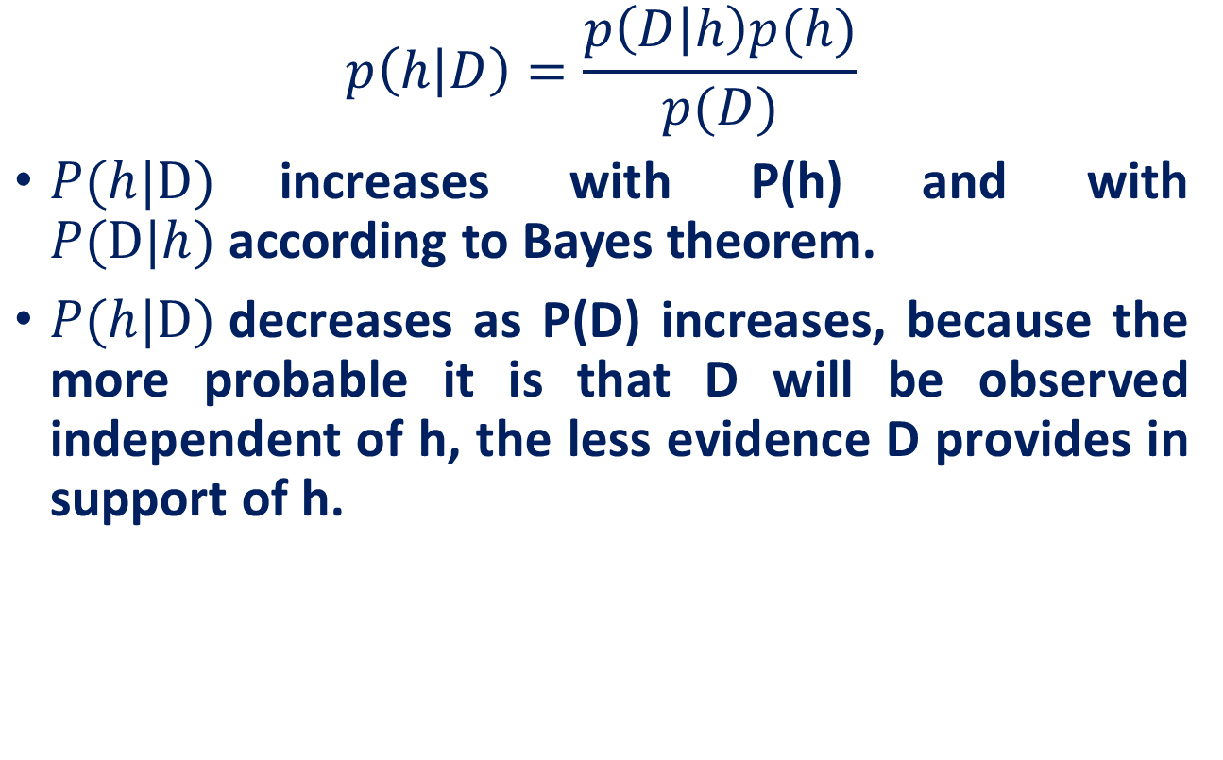
Bayes Theorem

Slide 13
Bayes Theorem
Does patient have cancer or not?
A patient takes a lab test and the result comes back positive. The test returns a correct positive result in only 98% of the cases in which the disease is actually present, and a correct negative result in only 97% of the cases in which the disease is not present. Furthermore, 0.008 of the entire population have this cancer.

Slide 14
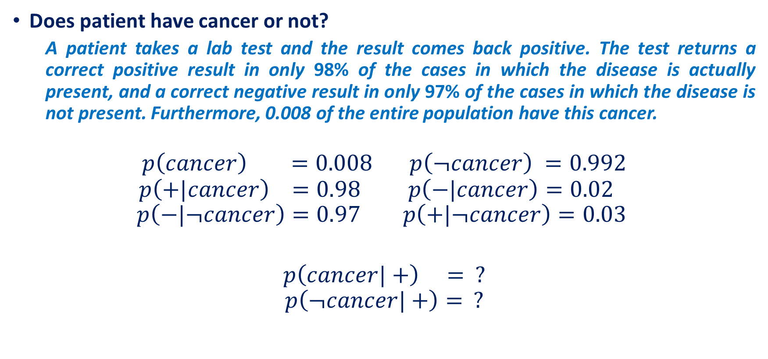
Bayes Theorem

Slide 15
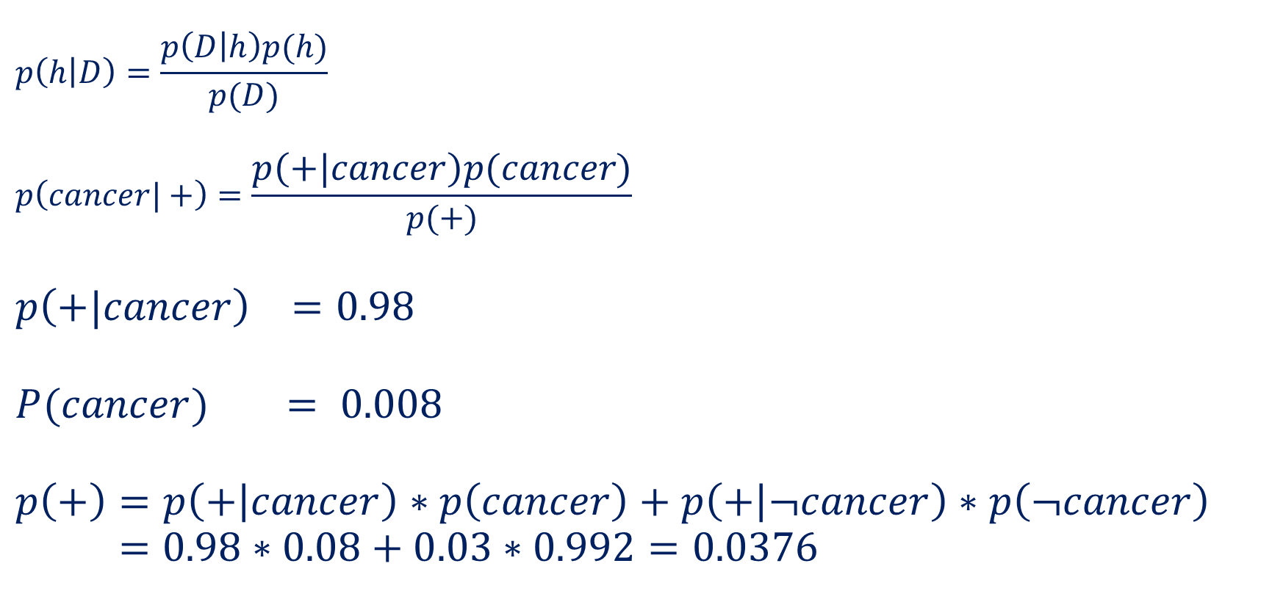
Bayes Theorem

Slide 16
Naive Bayes Classifier
Along with decision trees, neural networks, nearest nbr, one of the most practical learning methods.
When to use
Moderate or large training set available
Attributes that describe instances are conditionally independent given classification
Successful applications:
Diagnosis
Classifying text documents

Slide 17
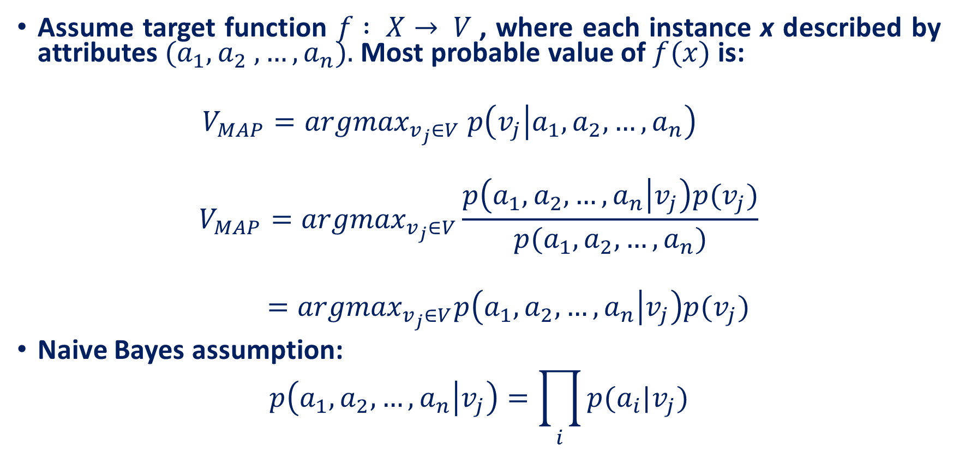
Naive Bayes Classifier

Slide 18
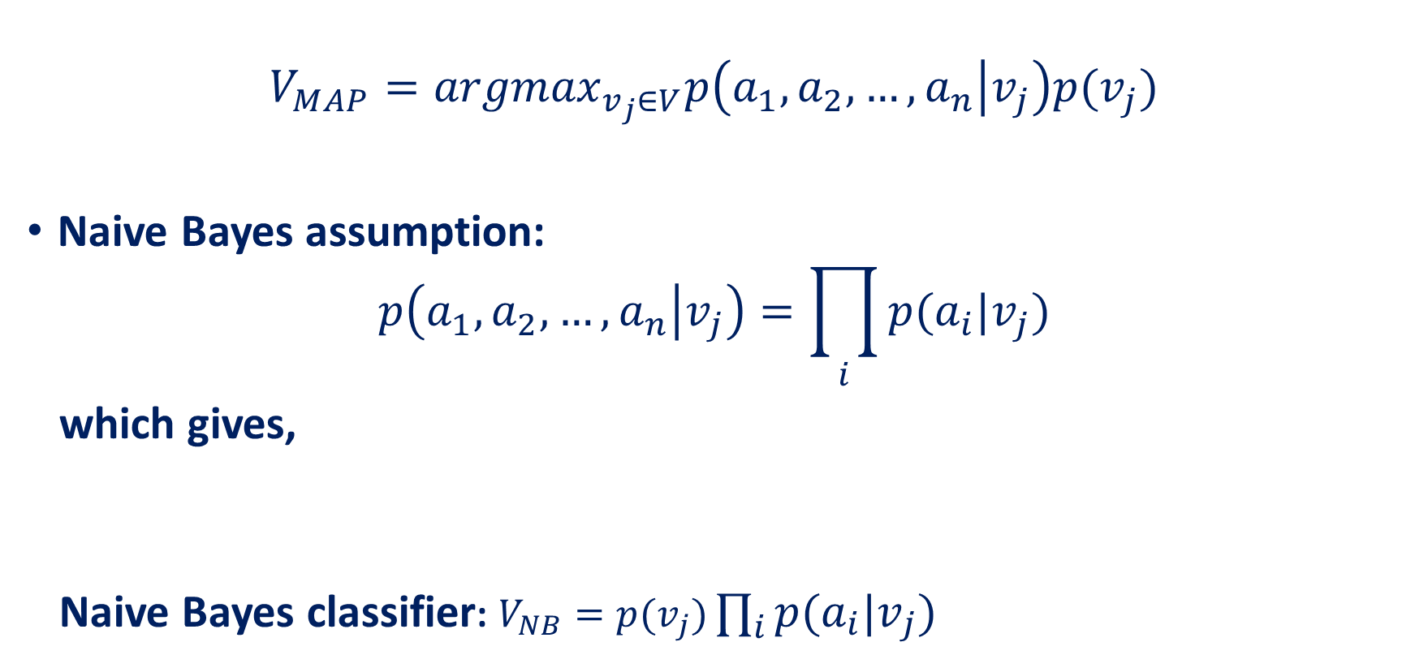
Naive Bayes Classifier

Slide 19
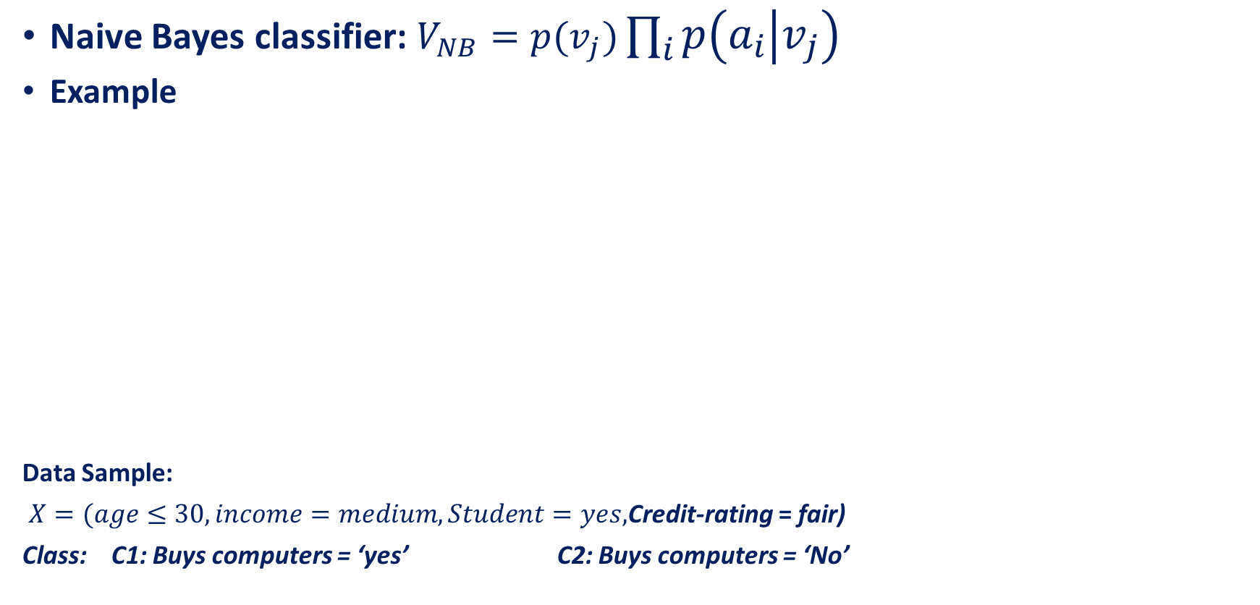
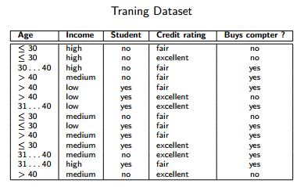
Naive Bayes Classifier

Slide 20
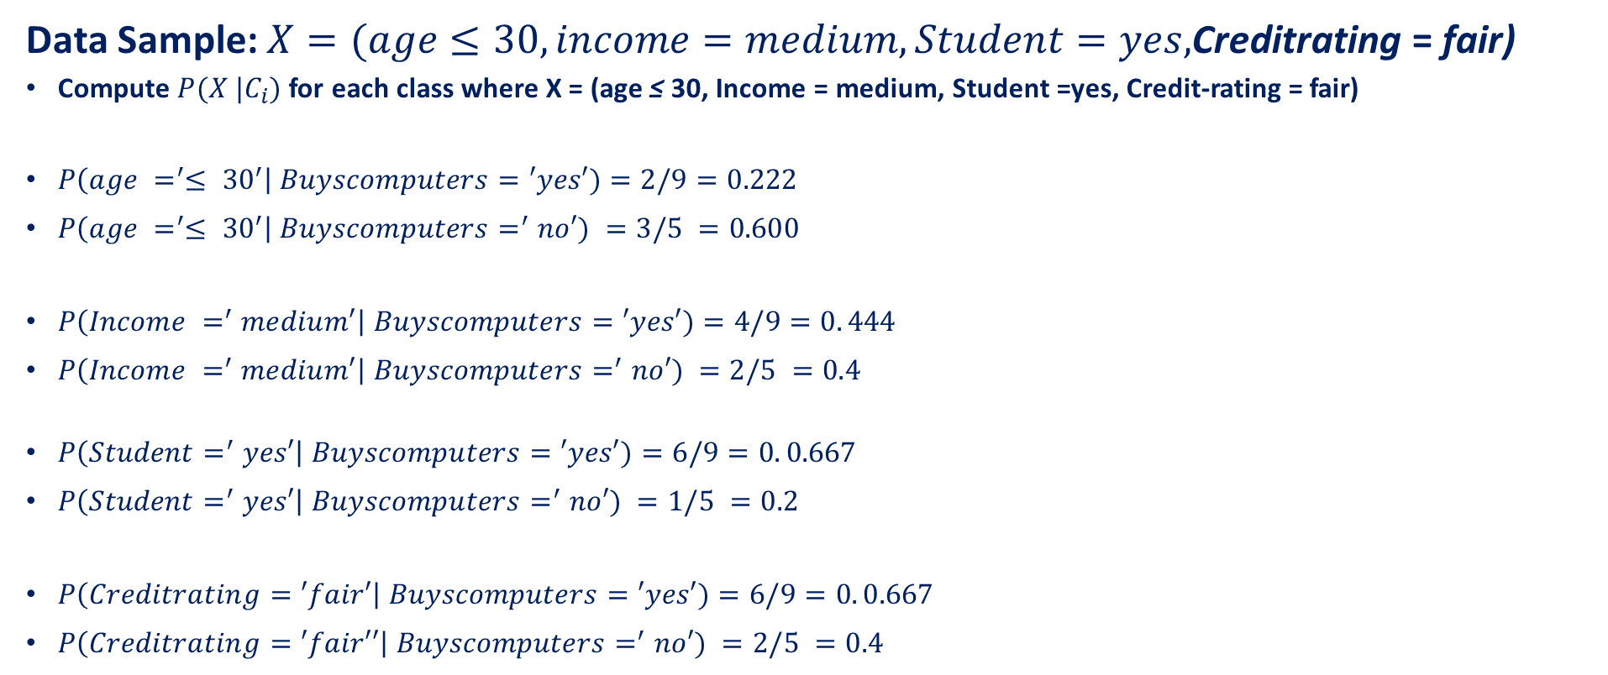
Naive Bayes Classifier

Slide 21
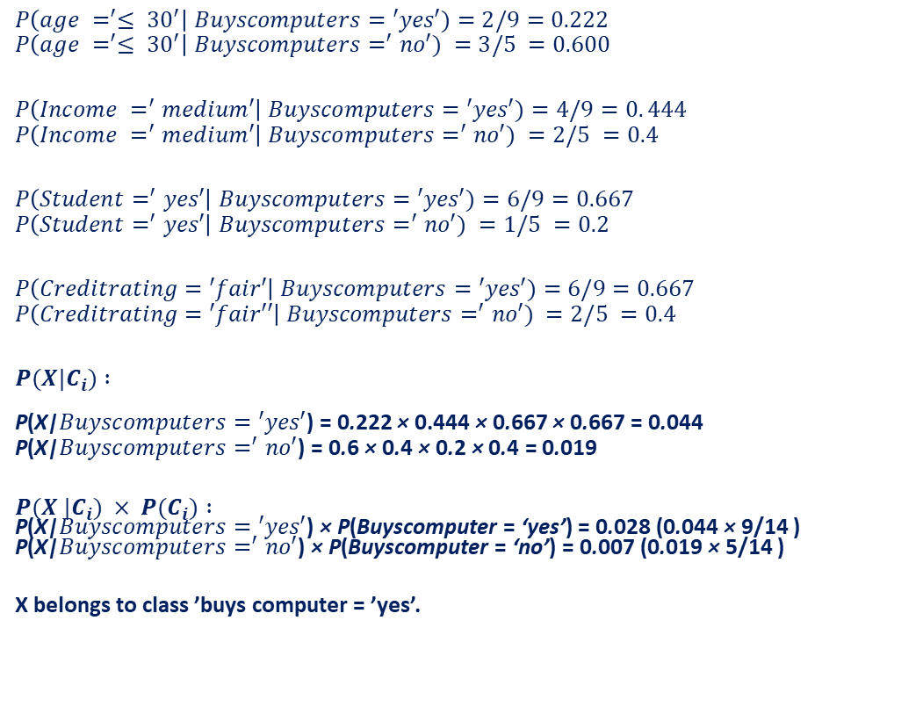

Naive Bayes Classifier

Slide 22
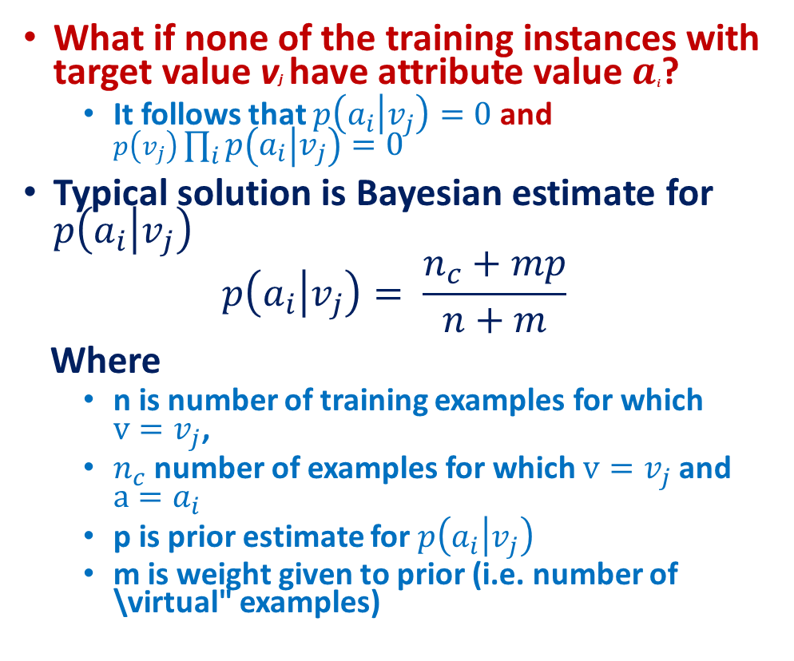
Naive Bayes Classifier

Slide 23
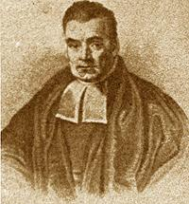
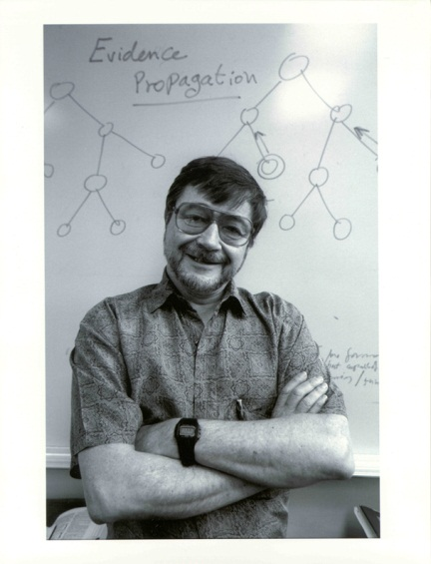
Bayesian Network Motivation
We want a representation and reasoning system that is based on conditional independence
Compact yet expressive representation
Efficient reasoning procedures
Bayesian Networks are such a representation
Named after Thomas Bayes (ca. 1702 –1761)
Term coined in 1985 by Judea Pearl (1936 – )
Their invention changed the focus on AI from logic to probability!

Slide 24
Bayesian Networks
A Bayesian network specifies a joint distribution in a structured form
Represent dependence/independence via a directed graph
Nodes = random variables
Edges = direct dependence
Missing arcs encode conditional independence
Structure of the graph ⬄ Conditional independence relations
Requires that graph is acyclic (no directed cycles)
Two components to a Bayesian network
The graph structure (conditional independence assumptions)
The numerical probabilities (for each variable given its parents)
Efficient representation of joint PDF P(X)
Generative model (not just discriminative): allows arbitrary queries to be answered, e.g.
P (lung cancer=yes | smoking=no, positive X-ray=yes ) = ?

Slide 25
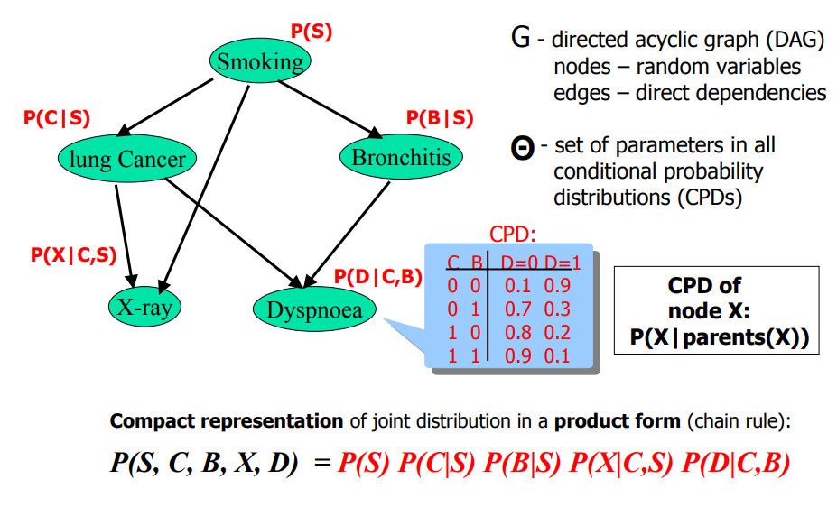

Slide 26
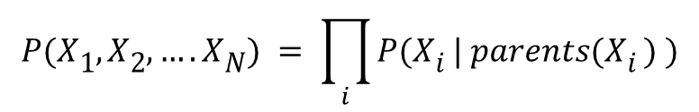
Bayesian Networks
General form:
The full joint distribution
The graph-structured approximation

Slide 27
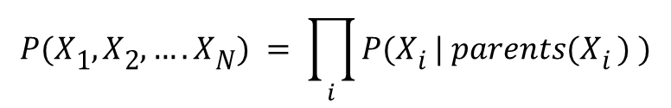

Example of a simple Bayesian network
A
B
C
Probability model has simple factored form
Directed edges => direct dependence
Absence of an edge => conditional independence
Also known as belief networks, graphical models, causal networks
Other formulations, e.g., undirected graphical models

Slide 28
Examples of 3-way Bayesian Networks
A
B
C
Absolute Independence:
p(A,B,C) = p(A) p(B) p(C)

Slide 29
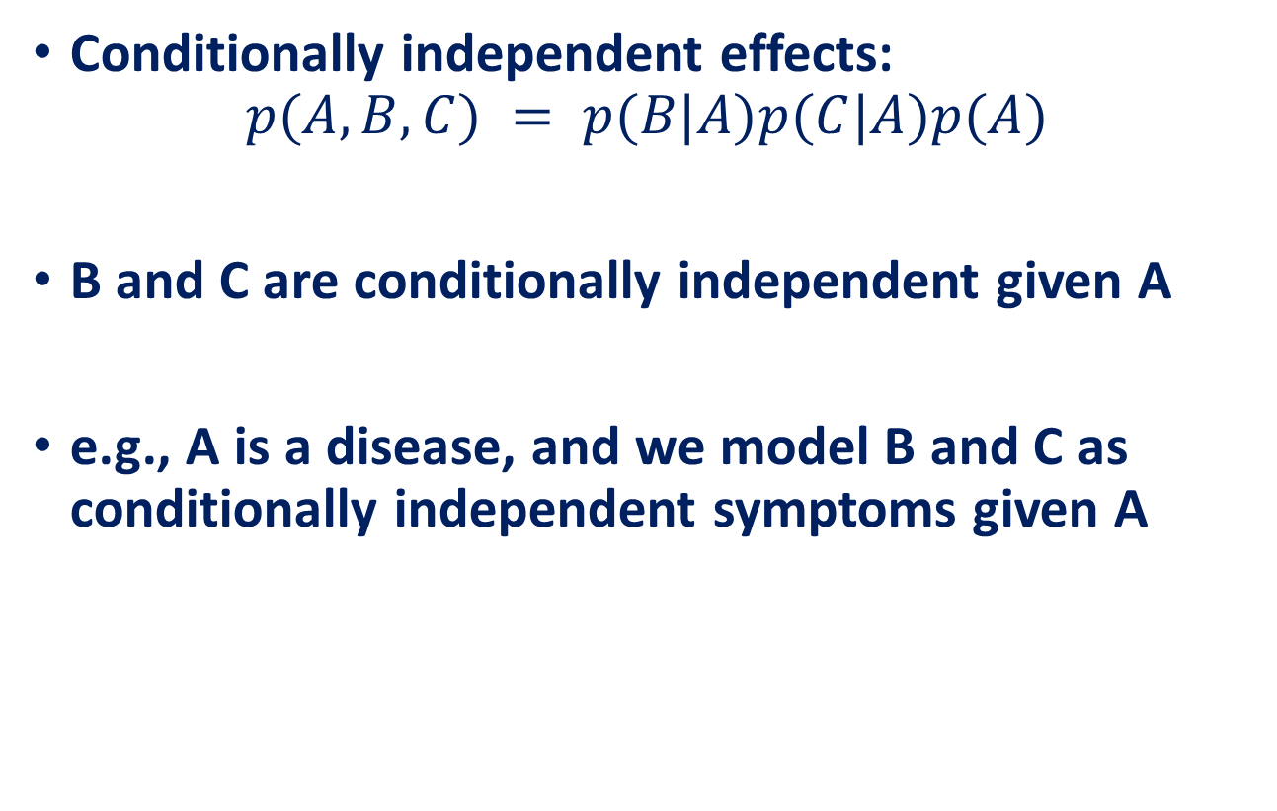
Examples of 3-way Bayesian Networks
A
B
C

Slide 30
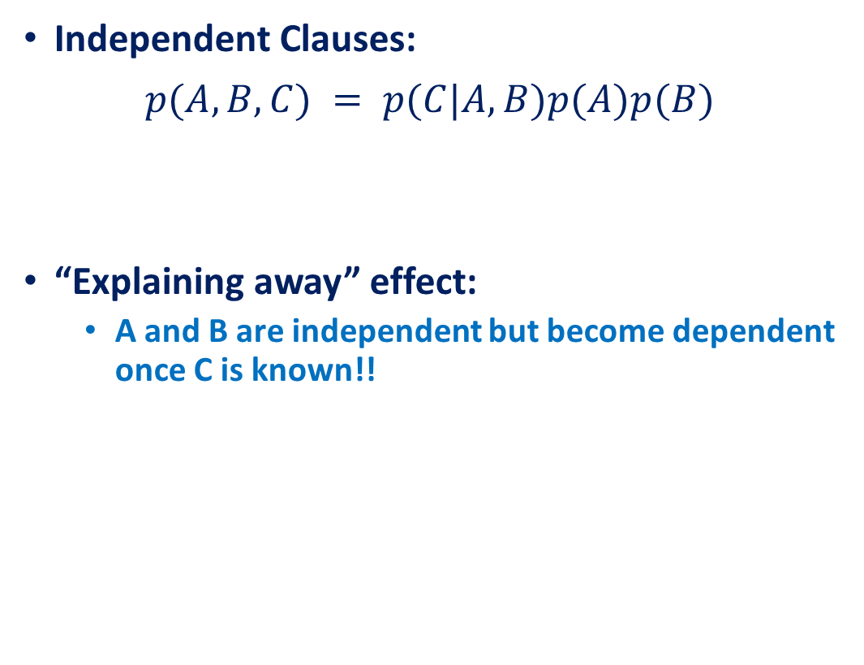
Examples of 3-way Bayesian Networks
A
B
C

Slide 31
Examples of 3-way Bayesian Networks
A
B
C
Markov dependence:
p(A,B,C) = p(C|B) p(B|A)p(A)

Slide 32
The Alarm Example
You have a new burglar alarm installed
It is reliable about detecting burglary, but responds to minor earthquakes
Two neighbors (John, Mary) promise to call you at work when they hear the alarm
John always calls when hears alarm, but confuses alarm with phone ringing (and calls then also)
Mary likes loud music and sometimes misses alarm!
Given evidence about who has and hasn’t called, estimate the probability of a burglary

Slide 33
Represent problem using 5 binary variables:
B = a burglary occurs at your house
E = an earthquake occurs at your house
A = the alarm goes off
J = John calls to report the alarm
M = Mary calls to report the alarm
What is P(B | M, J) ?
We can use the full joint distribution to answer this question
Requires 2⁵ = 32 probabilities
Can we use prior domain knowledge to come up with a Bayesian network that requires fewer probabilities?

Slide 34
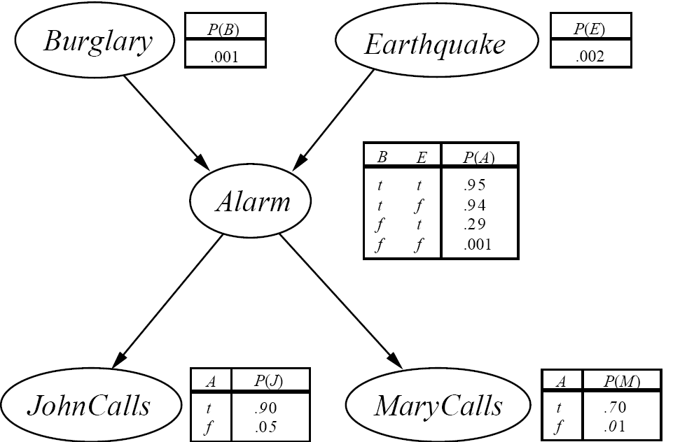
Order the variables in terms of causality (may be a partial order)
e.g., {E, B} -> {A} -> {J, M}
Use these assumptions to create the graph structure of the Bayesian network

Slide 35
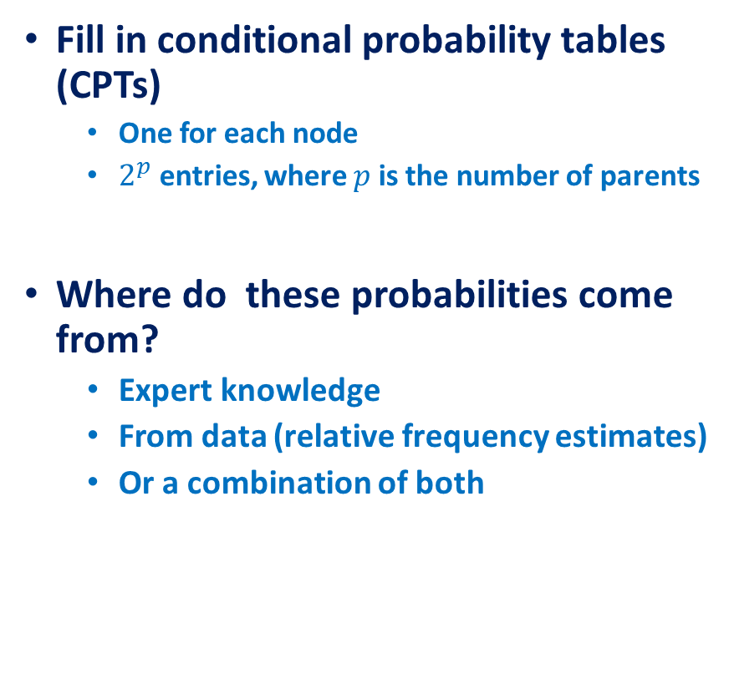


Slide 36
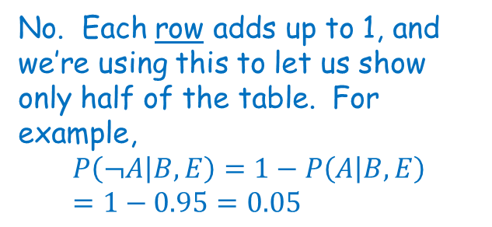
The Bayesian network
Shouldn’t these add up to 1?

Slide 37
The Bayesian network
What is P(j ∧ m ∧ a ∧ ¬b ∧ ¬e)?
P (j | a) P (m | a) P (a | ¬b, ¬e) P (¬b) P (¬e)

Slide 38
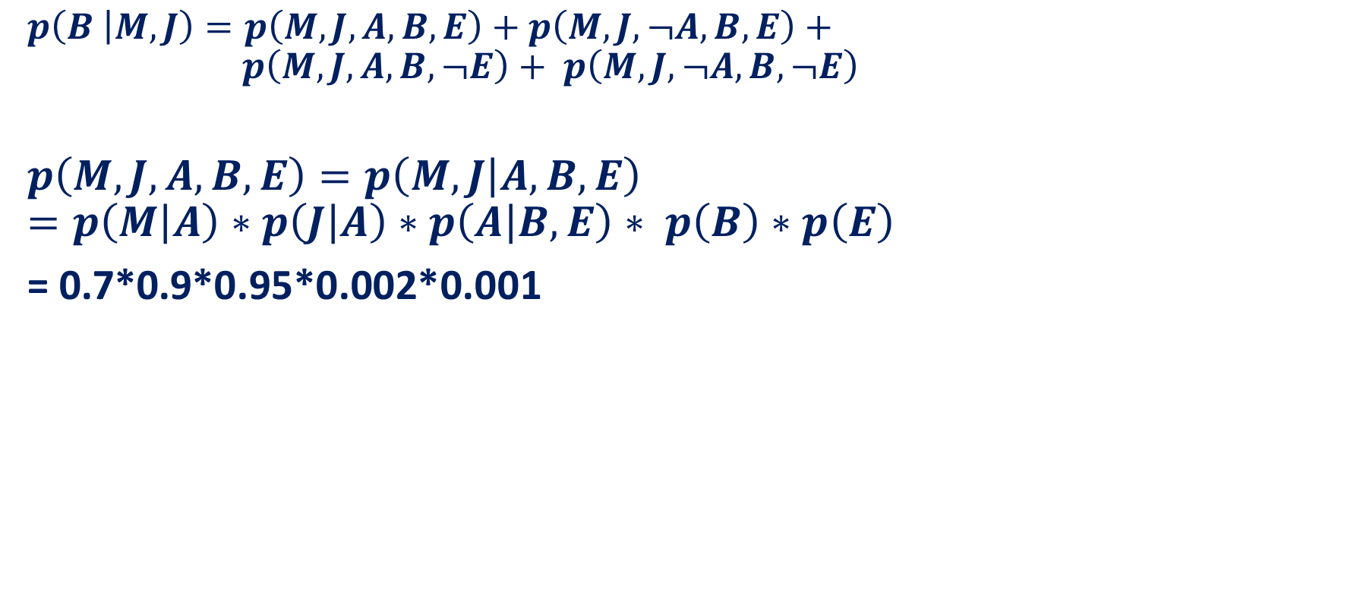
The Bayesian network

Slide 39
Number of Probabilities in Bayesian Networks
Consider n binary variables
Unconstrained joint distribution requires O(2^{n}) probabilities
If we have a Bayesian network, with a maximum of k parents for any node, then we need O(n 2^{k}) probabilities

Slide 40
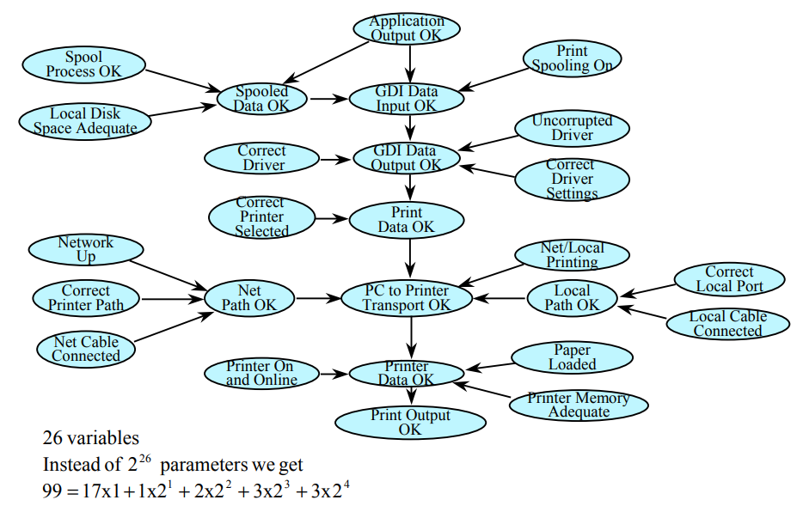
Number of Probabilities in Bayesian Networks

Slide 41
Conditional Independence
There is a general topological criterion called d-separation
d-separation determines whether a set of nodes X is independent of another set Y given a third set E
We will use the notation I(X, Y | E) to mean that X and Y are conditionally independent given E
Theorem [Verma and Pearl 1988]:
If a set of evidence variables E d-separates X and Y in the Bayesian Network’s graph, then I(X, Y | E)
d-separation can be determined in linear time using a DFS-like algorithm

Slide 42
d-separation
Let evidence nodes E ⊆ V (where V are the vertices or nodes in the graph), and X and Y be distinct nodes in V – E.
We say X and Y are d-separated by E in the Bayesian network if every undirected path between X and Y is blocked by E.
What does it mean for a path to be blocked? There are 3 cases…

Slide 43
d-separation
Case 1
There exists a node N on the path such that
It is in the evidence set E (shaded grey)
The arcs putting N in the path are “tail-to-tail”.
X
N
Y
X = “Owns expensive car”
N = “Rich”
Y = “Owns expensive home”
The path between X and Y is blocked by N

Slide 44
d-separation
Case 2
There exists a node N on the path such that
It is in the evidence set E
The arcs putting N in the path are “tail-to-head”.
X
N
Y
X=Education N=Job Y=Rich
The path between X and Y is blocked by N

Slide 45
d-separation
Case 3
There exists a node N on the path such that
It is NOT in the evidence set E (not shaded)
Neither are any of its descendants
The arcs putting N in the path are “head-to-head”.
X
N
Y
The path between X and Y is blocked by N (Note N is not in the evidence set)

Slide 46
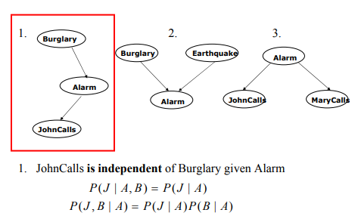
Conditional Independence

Slide 47
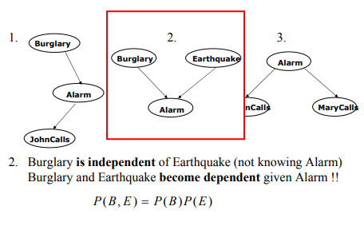
Conditional Independence

Slide 48
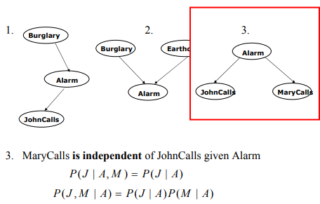
Conditional Independence

